Slide 1
First Expert Symposium: Illegal Fishing in Southern African Waters and Beyond Prevention and Law Enforcement
IUU fishing: profits, plunder, port state jurisdiction & flags of convenience
Emma Witbooi
Institute of Marine & Environmental Law
University of Cape Town
July 2013

Slide 2
Overview
Introduction to IUU fishing
Port state control
Flags of convenience
Conclusions

Slide 3
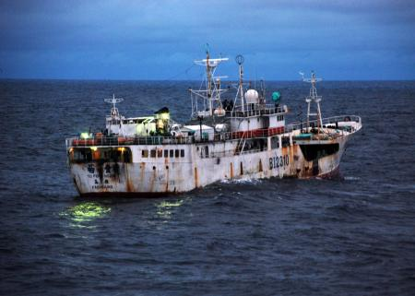
Notes:
Suspected IUU vessel of Sierre Leone

Slide 4
Introduction to IUU fishing
Challenges of IUU fishing
Illegal, unreported & unregulated fishing
Law: prevent, deter & eliminate
International law: port & flag state control
Shift to port state: powerful, cost-effective & untapped enforcement tool hitting at profitability
Frustrated by flags of convenience

Slide 5
Port state control
Merchant ships: maritime safety
Paris Memorandum of Understanding
Fishing vessels:
Terremolinos Protocol (1977): fishing vessels 24m +
UNCLOS
Need for clear legal guidelines on jurisdictional issues
Port state: full jurisdiction
Flag state jurisdiction
Suspected IUU fishing – powers & duties respective states

Slide 6
Port State Control: the law
UNCLOS
conditions of access to their ports & take steps to prevent breach
1995 Fish Stocks Agreement
Sovereignty of states in ports
measures to promote effectiveness regional & global conservation measures eg inspecting documents, gear
regulations to prohibit landing, transshipment
2005 FAO Model Scheme on Port State Measures
2009 Port State Measures Agreement

Slide 7
2009 Port State Measures Agreement
Background :
FAO Plan of Action to Prevent, Deter & Eliminate IUU Fishing: prior notice, docs & denial if clear evidence IUU fishing
Denial of use of port :
Prior to entry: sufficient proof IUU fishing
Upon entry: suspicion IUU fishing
Reasonable grounds: deny landing, transshipping etc
Inform
After inspection: clear grounds IUU fishing
Deny landing, transshipping, packaging & processing
Inform

Slide 8
Port State Control
Port state may take ‘additional measures in conformity with international law’
Detention ?
UNCLOS: no clear guidance
1995 Fish Stocks Agreement: draft provision excluded
Commentators: until flag state willing to take control?
Forfeiture?
2005 FAO Port State Model Scheme: draft clause permitting forfeiture fish ito national law excluded
Deprivation of nationals of benefits of IUU fishing

Slide 9
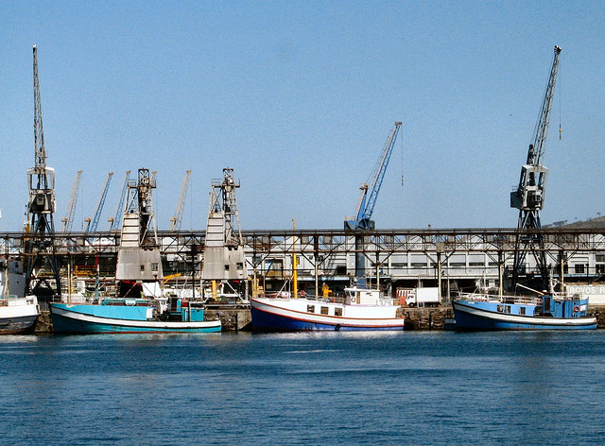
Notes:
Fishing vessels in CT harbour

Slide 10
South Africa port state control
Fragmented legally & administratively
Commercial ports & fishing harbours
Commercial ports:
Transnet National Port Authorities (National Ports Act)
Merchant ships: Port State Control Officers (SAMSA Act)
Fishing ships: Fisheries Control Officers (MLRA)
Foreign fishing vessels wanting to enter SA port:
EEZ permit (MCM, Department Environment)
Port entry permit (National Ports Act)

Slide 11
South Africa port state control
EEZ permit conditions:
Fish caught in RFMO areas
FCOs: suspected violation MRLA
Specific port state measures:
Not party to 2009 Port State Measures Agreement
Member various RFMOs: deny access on suspicion IUU fishing (information or ‘black list’)
MRLA: may notify flag state if suspicion contravention international conservation measures

Slide 12
Port state control: complimentary enforcement measures
Lacey Act long-arm enforcement approach
Offence import, export & possess in violation foreign law
IPOA-IUU: steps to prevent IUU fish in RFMO areas traded or imported
Ministerial-led High Seas Task Force on IUU Fishing
Other trade and market measures:
RFMOs: catch certification & trade documentation schemes

Slide 13
Flags of convenience
Country whose flag vessel flies responsible for activities at sea (UNCLOS)
‘Open registries’
Flag state: economic benefits
Ship owners: low registration fees, quick registration etc
Problems:
flags of convenience – flag of state unwilling or unable to control its vessels’ activities
Owner of vessels difficult to determine
‘Flag-hopping’ makes IUU vessels hard to track

Slide 14
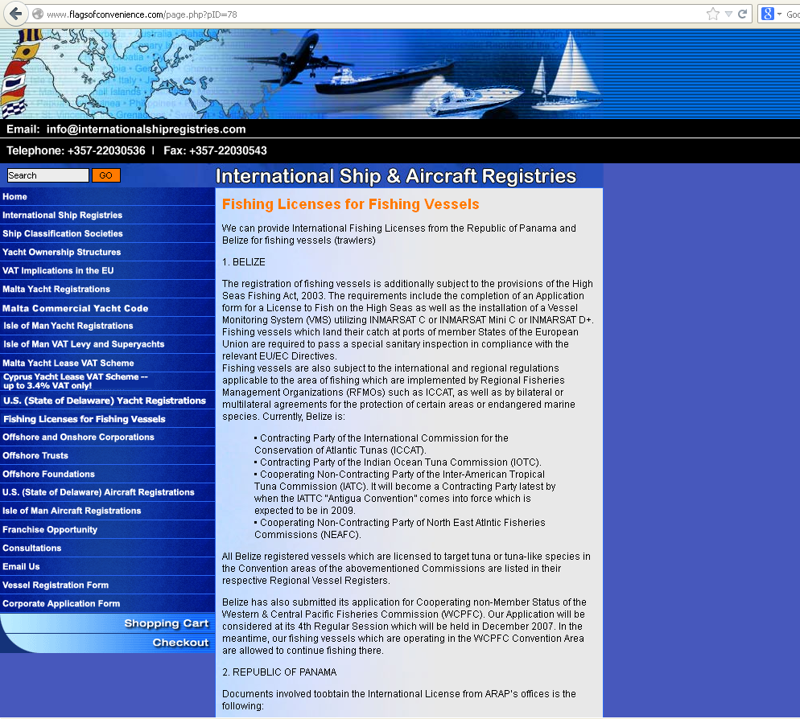
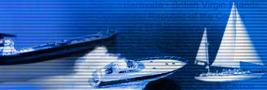
Notes:
Example of open register online

Slide 15
Genuine link
Why is there not greater control over flagging of vessels?
Reluctance to see ‘genuine link’ between flag state & ship as precondition for registration
UNCLOS: all ships to be flagged to a state with which they have a ‘genuine link’ (arts 94 & 91(1))
What constitutes ‘genuine link’?
Shift focus from pre-conditions link to responsibilities: capacity & willingness ensure compliance:
IPOA-IUU: flag state to ensure it can exercise its responsibility to ensure vessel not engage in IUU fishing

Slide 16
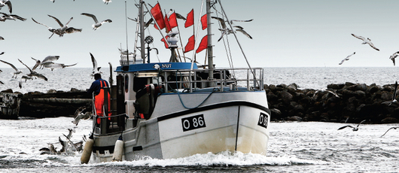

Slide 17
South Africa: genuine link
economic factors ie ownership
To fly SA flag vessel to be:
registered in SA, or
‘entitled to be registered in SA’: includes fishing vessels wholly-owned by SA natural or juristic persons
SA national includes body corporate established in SA with ‘a place of business’ in SA
Shift away to international trend of effective control?

Slide 18
Conclusions
Tackling flags of convenience:
Genuine link: Shift towards flag state’s responsibility to control vessel’s fishing activities
Soft law to binding agreements?
Port state control:
Harmonised, stricter port state controls & expanded port state jurisdiction (detention? Forfeiture?)
Expanded use market-related tools: Lacey-Act type legislation?
Ratification 2009 Agreement
Encouragement join RFMOS & RFMOs improve effectiveness:

Slide 19
Conclusions
Generally:
Global register all fishing vessels on HS
Global IUU fishing vessel list &/or wide-spread access lists RFMOs
Unique vessel identification number?
Wide-spread sharing of accurate information on IUU fishing activities real-time

