Slide 1
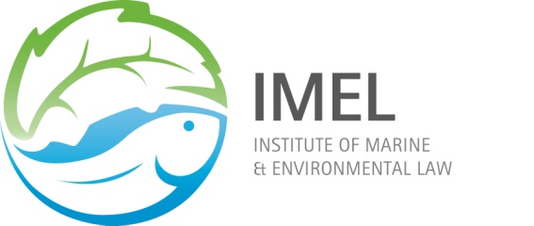
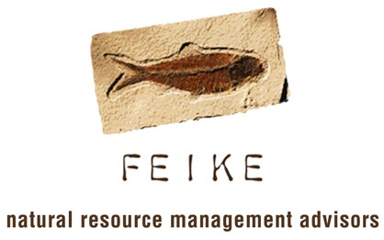
Symposium on IUU Fishing in Southern African Waters & Beyond:
Prevention And Law Enforcement
Constraints & Opportunities: Enforcing South African Fisheries Laws
W: www.feike.co.za
B: Feikemanagement.blogspot.com
T: @feikemanagement

Slide 2
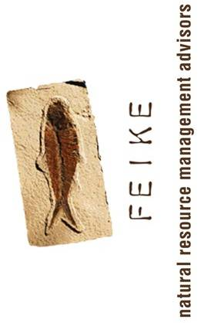
My Argument… In an Abalone Shell
Fisheries compliance in SA today is in meltdown
There is no definitive enforcement policy or strategy for M&E purposes.
On 19 February 2013, Fisheries Dept reported to Parliament that –
“The offshore fisheries and the EEZ are not being patrolled. We therefore cannot determine whether any IUU fishing is taking place”.
SA’s fleet of patrol vessels and RIB’s are inoperative & have been so since 1 April 2012
No fisheries observer programme either
A shore-based monitoring programme with significant shortcomings
Arrest but without the follow-through

Slide 3
My Argument… on the +ve Side
The Fisheries Department’s Special Investigations Unit
The City of Cape Town’s Marine Law Enforcement Unit
Table Mountain National Parks Marine Protected Area Management Unit

Slide 4
The Fixer: An Opportunity for Fisheries
Schedule 4 (Part A) of the Constitution:
Marine resource management vests exclusively in national government (DAFF)
Both the MLRA and precedent support devolution of enforcement authority
MLRA – section 78
“The Minister may assign the administration of any provision of this Act to the executive authority of a province.”
History – Operation Trident (we need a clear & coherent compliance & enforcement strategy) –
Green Courts (the cases of Marx and Ross)
National, Provincial and local enforcement co-ordination (the case of abalone & lobster outside of the City of Cape Town)
Partnerships with NGO’s and fishing communities
A strong DAFF - we need boats at sea, FCO’s on the beat (not until 4pm) and an expanded SIU (the Case of Hout Bay Fishing Industries)

