Slide 1
Small-scale Fishers: Perspectives on enforcement and implementation Fish Symposium, Institute of Marine and Environmental Law (IMEL)
INSTITUTE FOR POVERTY, LAND AND AGRARIAN STUDIES (PLAAS)
Moenieba Isaacs

Slide 2
Outline
Small-scale fisheries
Compliance
Co-management
Implementation

Slide 3
Situating Small-scale Policy
Small-scale fisheries policy – court case in 2004, out of court settlement in 2007, Interim rights allocation, New small-scale policy in 2012
Amendment of Draft Marine Living Resource Amendment Bill 2013 to accommodate SCF
Rights Allocation Policies (Quotas)
FAO Guidelines on Small Scale Fisheries (Draft)

Slide 4
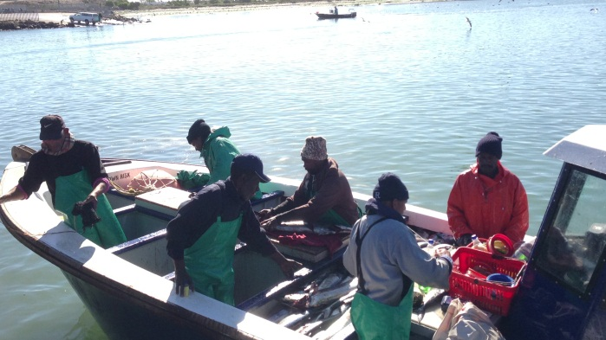
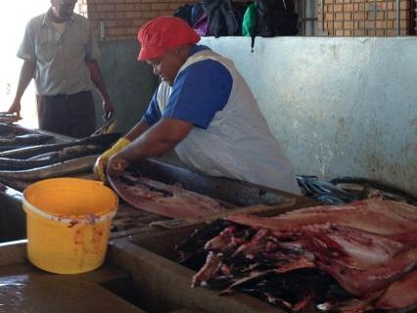
Small-scale fisheries in South Africa
Right to be recognised
Right to livelihood
Nutrition and Food Security
Paradigm shift from Individual
Transferable Quotas (neo-liberal,
Privatised rights)
Collective Rights Allocation
Creation of a legal entities
Multi-species
Preferential Access to inshore
species
Versus
ITQ system is mainstreamed in fisheries
(Big companies, BEE (race and gender, new entrants, and interim rights).

Slide 5
Governance, Monitoring and Enforcement (Small-scale Policy)
Co-management – people centred and community oriented
Promotes – social equity, justice and collective governance of marine living resources
Empowerment of fishers to participated in developing, implementing, and evaluating fishery policies and management plans
Devolution of some management decisions to communities and inclusion of provincial and local government. making powers

Slide 7
Zoning and Species

Slide 8
Conclusion
Small-scale implementation Plan
Type of rights allocation
Integrating the current rights holders into the framework of small-scale policy
Differentiate between the corporate and non-corporate value chains (nutrition and food security).

