Slide 1
Marine Fisheries Symposium
USA v Bengis
Lessons for South Africa
Professor Jan Glazewski
Institute of Marine & Environmental Law
University of Cape Town
July 2013

Slide 2
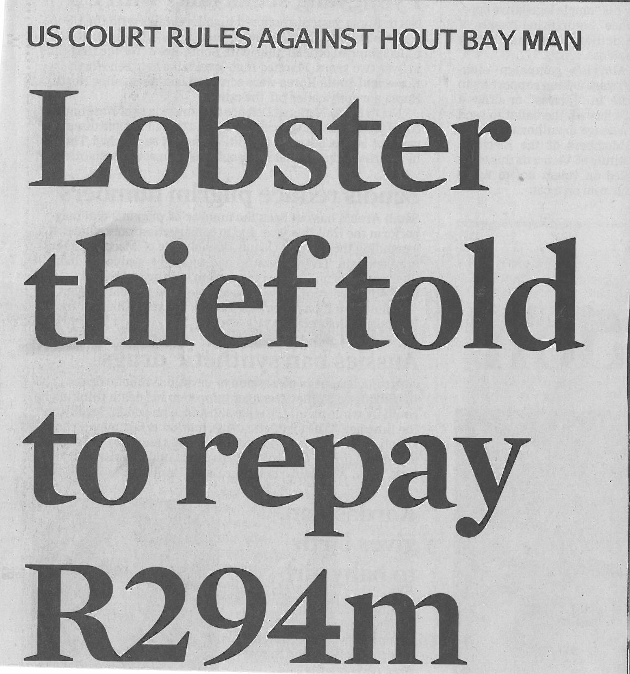

Slide 3
Headline News: USA v Bengis
14 June 2013
- New York District Court hands down restitution order in an amount of $29 mill.
- Defendants ordered to pay South Africa compensation for damage to fish stocks;
- Significant implications for wildlife law generally, not only marine fisheries.

Slide 4
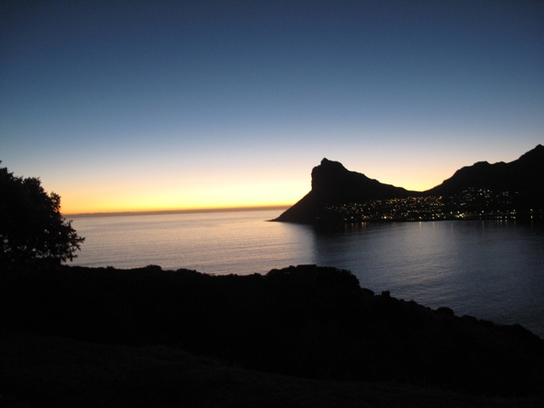

Slide 5
Background 1: Timeline (South Africa)
Period 1987 to 2001:
Bengis and son & Geofrey Noll (+ many others) plundered tons of West Coast & South Coast Rock Lobster (and Patagonian Toothfish) from South African 200n.mile EEZ (and beyond 200 n.mile zone: CCAMLR area)
2001: Apprehended when crates destined for USA opened by South African fishing inspectors.

Slide 6
Background 2: (South Africa)
Year 2002
Arnold Bengis (Hout Bay Fishing (Pty) Ltd)
Appears in South African magistrates court
. Guilty Plea.
Fined US $1.2 (R12 million);
Forfeits two vessels
TOTAL sanction in SA: US $7,049,080

Slide 7
South African Law: Marine Living Resources Act, 1998
Act itself
an offense to harvest, process, or possess fish without a permit; exceed quota;
Regulations under Act MLRA
Offences: Offence to transfer at sea any fish without supervision of a fishery control officer.

Slide 8
Background 2: United States
2004 New York District Court
– Criminal sanction Guilty Plea:
– US $13,300mill (about R26 mill)
2007 New York District Court
– Restitution: Three key questions
2008/2011 Court of Appeal
– Restitution: Three key questions
2013 New York District Court (resolved!!!!!??)

Slide 9
Three key questions: Restitution Laws
Who is owner of marine resources in South Africa’s 200 n.mile EEZ; property interest?
Is South Africa a “victim’ under US restitution laws;
How to quantify amount of restitution
(what is economic value of illegally captured fish)

Slide 10
United States Law 1: Criminal Sanction Lacey Act, 1900
It is unlawful for any person—
(2) to import, export, transport, sell, receive,
acquire, or purchase in interstate or foreign
commerce
(A) any fish or wildlife taken, possessed,
transported, or sold in violation of any law or
regulation of any State or in violation of any
foreign law;…”

Slide 11
United States Law 2: Restitution Laws
Mandatory Victims Restitution Act (MVRA)
Mandatory Sanction
Voluntary Witness Protection Act (VWPA)
Discretionary sanction

Slide 12
Key Question 1: Ownership Return day: New York District Court
Court dismisses USA request for restitution to South Africa
under MVRA
- “the state does not own the fish”
- not a “property” interest, but regulatory one

Slide 13
Key question 1: Ownership Common Law: Nature of things/property
Res Nullius
Owned by nobody but subject to capture
Res Publicae
Owned by the State on behalf of peop
Appeal Court held:
Defendants conduct deprived South Africa of money it was due; SA: a property interest

Slide 14
Key question 1: Ownership/property Appeal Court
“…conspiracy to conceal their illegal trade in lobster deprived South Africa of money it was due. …defendants conduct deprived South Africa of proceeds from the sale of illegally harvested lobsters.”
As such depriving South Africa of that revenue is an offence against property;
South Africa has a property interest even though not literally owner of the fish

Slide 15
Key Question 1: Who is owner of resource Public Trust Doctrine
NEMA Principles:
[t]he environment is held in public trust for the people, the beneficial use of environmental resources must serve the public interest and the environment must be protected as the people’s common heritage.… (sect. 2(4)(o)

Slide 16
Key question 2 Mandatory Victims Restitution Act (MVRA)
MVRA: …the term "victim" means a person directly and proximately harmed as a result of the commission of an offense for which restitution may be ordered…
District Court 2
South Africa not a “victim” as defined

Slide 17
Key question 2 Was South Africa a victim?
Argument upheld by Appeal Court :
South Africa is a victim as defined
Defendant’s conduct “directly harmed” the South African government making it a “victim” under the MVRA and VWPA and eligible for restitution

Slide 18
Key Question 3 Measuring value of resource
South African Department of Marine and Coastal Management commissions report from Ocean and Land Resource Assessments Consultants (OLRAC),
Cape Town
Submitted to the United Sates.

Slide 19
Key Question 3: Valuing resource OLRAC Report: Two options
Option 1:
Catch forfeit /cost of remediation method
Estimates restitution: $46.77 mill
Option 2:
Market value of the overharvested fish
Estimates restitution $61.93 mill
2006: Court refers to judge for report & recommendation

Slide 20
Key Question 3: Valuing resource District Court decision
District Court (Option 2): Market value:
West Coast Lobster $29.49 m
South Coast Lobster $32.43 m $61.92 m
Less Paid to South Africa (crime) 7.04 m
TOTAL $54.89 m
Less: South Coast Lobster 32.43 m
FINAL ORDER $22.46m

Slide 21
Take Home or Discussion Points
Implications for Rhino horn trade?
Insidious corruption (more than 3 defendants);
Decide on a central enforcement agency (DAFF/DEA/local authorities Navy?)
Capacity building/personnel;
Need to speed up legal process;
What to do with $22 mill (R247 mill);
Different approaches to different marine sectors?

Slide 22
South Africa and the region Where do we go to from here?

