Slide 1
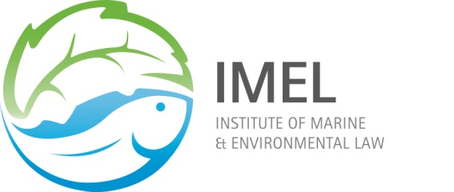
UNIVERSITY OF CAPE TOWN
INSTITUTE OF MARINE & ENVIRONMENTAL LAW (IMEL)
AND
MARINE RESEARCH INSTITUTE (Ma-Re)
FIRST EXPERT SYMPOSIUM ON ILLEGAL FISHING IN SOUTHERN AFRICAN WATERS AND BEYOND PREVENTION AND LAW ENFORCEMENT

Slide 2
Sectors of South African Fishery
Demersal
Pelagic
Line
Abalone
Rock lobster
Sea-weed/kelp
Marine mammals

Slide 3
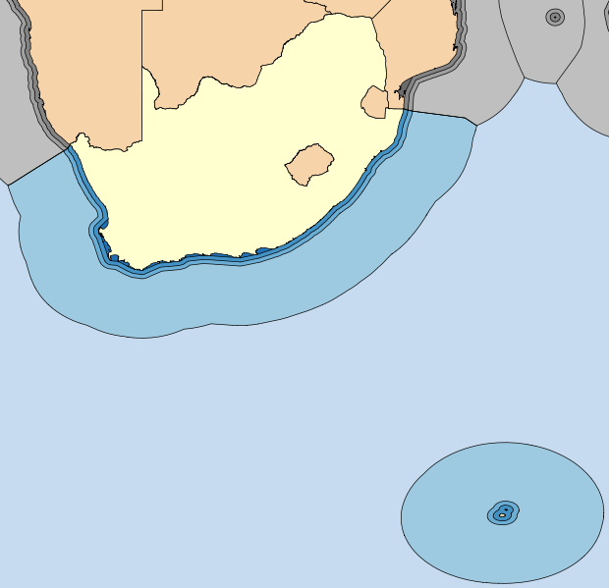
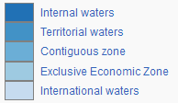

Slide 4
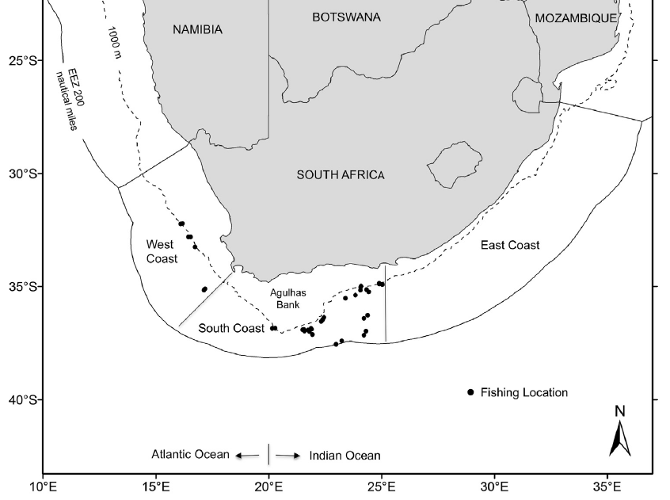
Demersal trawl
Pelagic purse seine
Line
West coast rock lobster
Abalone

Slide 5
Patagonian Toothfish

